Slide 1
Evaluating For Grades
Chapter 14 – Rebecca, Burton, Robert & Stephen

Slide 2

Agenda
Activity
What does a grade mean?
The politics of grades
Deriving grades
Maximizing your time
Reporting grades to learners
Trouble Shooting
Q & A
Closing

Slide 3

Can you make the grade??
ON A PIECE OF PAPER: assign a letter and number grade to the following examples of assessment
Do not share or discuss your grades with others.

Slide 4
Elementary Math Quiz 1. 3 x 4 = 12 2. 7+14 = 21 3. 24-11=13 4. 18÷2 = 9 Assign this student a number and letter grade

Slide 5
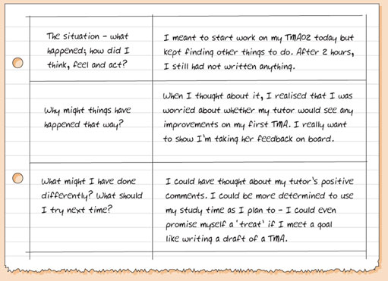
Reflective Journal Entry

Slide 6
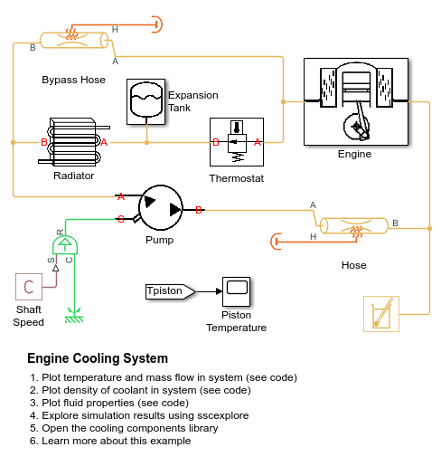
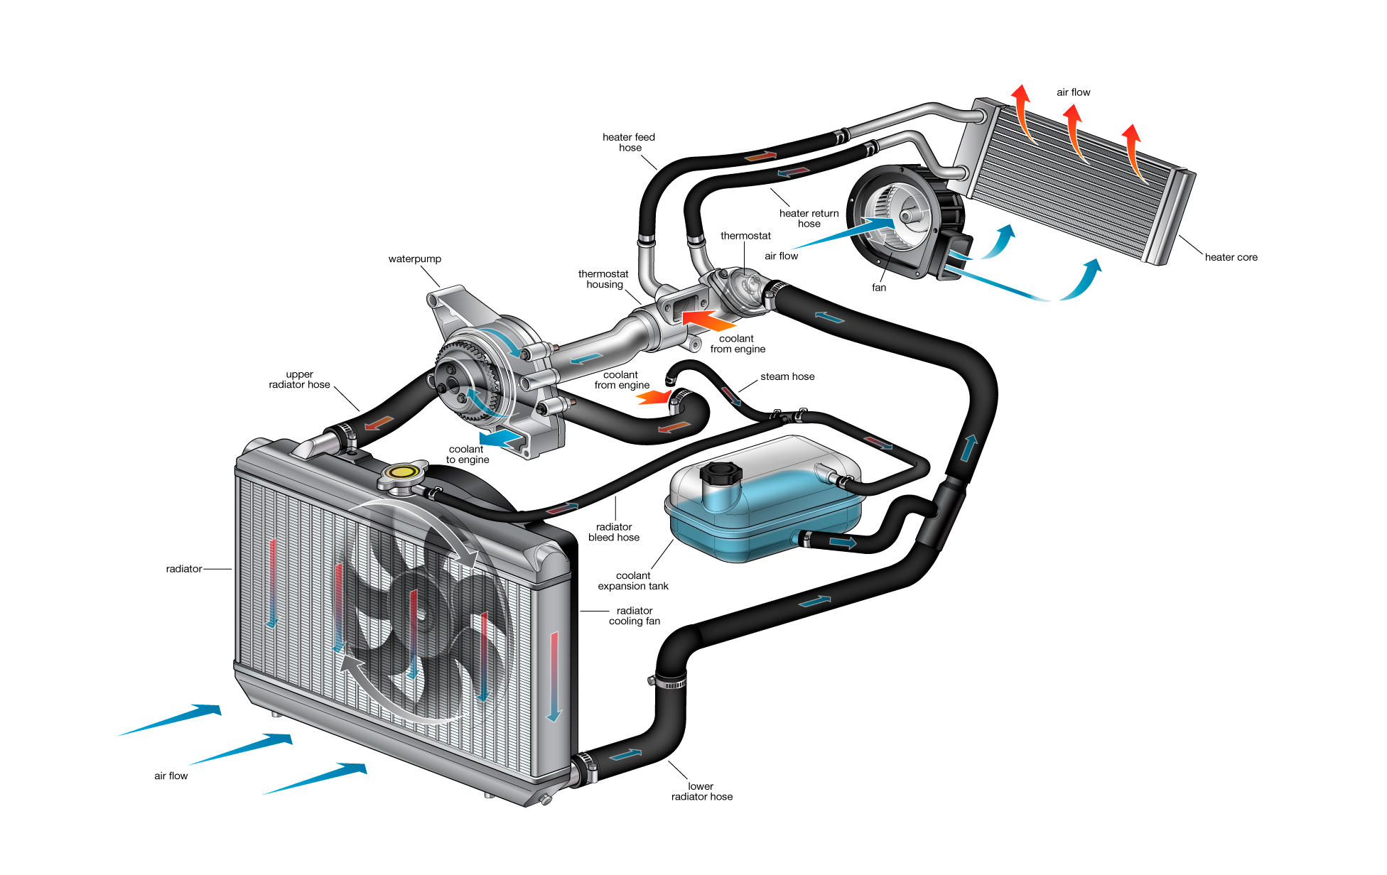
Diagram of engine cooling system- 2 submissions from 2 students

Slide 7

Student Demo: how to give a flu shot

Slide 8

Dance your PhD Contest
2017 WINNER
“Representations of the Braid Groups”

Slide 9
What does a grade mean?
“
If I ran a school, I’d give the average grade to the ones who gave me all the right answers, for being good parrots. I’d give the top grades to those who made a lot of mistakes and told me about them, and then told me what they learned from them.
-- R. Buckminster Fuller ”

Slide 10

What does a grade mean to the student?
Reward
Represents competence and hard work
How can hard work be accurately measured?
How is hard work related to learning?
Want to know how they compare to their peers

Slide 11
What does a grade mean to the student?
Norm Referencing
Learners are awarded grades based on their ranking within
Self Referencing
Learners compare their present performance to their past performance
Criterion Referencing
Determining grade based on clearly stated outcomes or standards for performance

Slide 12

What does a grade mean to the Instructor?
A few questions to ask yourself:
Does a grade…
represent the quality of students throughout the course?
represent only what the student can produce at the end of a course?
Show the percentage of skills the student can use when necessary?
Show exactly what the student has learned?

Slide 13

The Politics of Grades
Grading is philosophically, socially and politically driven.

Slide 14

The Politics of Grades
In certain occupations, grades are examined carefully by employers

Slide 15

The Politics of Grades
Fight the System
Use “credit” or “non-credit” as opposed to marks

Slide 16

The Politics of Grades
Subvert the system
Class participation
Daily course work
discussion

Slide 17

The Politics of Grades
Teach learners to ignore the system

Slide 18

The Politics of Grades
De-emphasize grading
There are no marks on your Power Engineering license

Slide 19

The Politics of Grades
Work with learners and instructors to change the system

Slide 20

Deriving the Grade: Issues to Consider
Choose meaningful assignments that allow students to demonstrate what they know in real-life situations
Avoid assignments that have no useful function outside the purpose of the grade

Slide 21
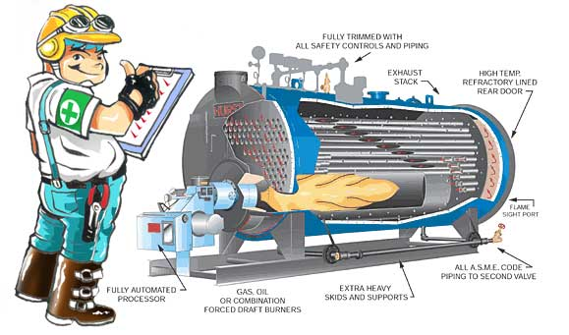
Deriving the Grade: Issues to Consider
Balance different types of activity for assessment
PET students are required to write procedures in the classroom and demonstrate their ability to start up equipment in the lab. A rubric is used to assess a numerical grade for both activities

Slide 22
Deriving the Grade: Issues to Consider
Make sure the majority of the work evaluated reflects the most important skill/knowledge of the program
It is assumed that learners demonstrate their level of knowledge at the conclusion of a program
I believe that power engineers require oral and writing communication skills. Log books.

Slide 23



Slide 24

Alternative Methods of deriving grades
Credit/Non-credit, Satisfactory/Unsatisfactory, or Complete
Self assessment
Performance approach
This approach is best suited to concrete, demonstrable learner performance, such as a technical skill

Slide 25

Maximizing your time
There is often too little
Efficient marking schemes
Holistic grading
Peer feedback

Slide 26

Reporting grades to learners
Communicate clear criteria
Deal with learner concerns
Allow learners to revise assignments

Slide 27

Trouble Shooting

Slide 28

What do you say when they ask… “Where did I lose marks?”
“You’re not losing marks, you’re gaining them”
The learner starts at zero and accumulates marks through effort, achievement and thought.
“72% means you are already 72 percent closer to meeting the goal”
Talk about their strengths first and then discuss the areas that need improvement

Slide 29
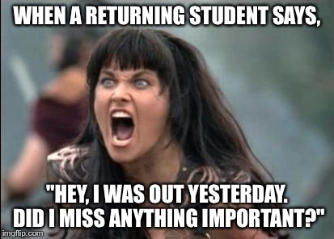
Grading for class participation Encouraging Attendance
Class Participation Marks -participation in group activities -classroom discussion -in class assignments: informal presentation, explain a procedure, create a poster, teach the teach, etc -in class surprise task or fun activity
Be careful not to award marks to the chattiest learner.

Slide 30
GRADING GROUPS | Advantages | Disadvantages
Peer Grading Every member of the group gives other members a grade | The people who contribute the most receive the highest mark | Learners require a high degree of maturity, critical thinking and honesty
Shared Grading Everyone in the group gets the same grade | -Requires the group to self-manage and delegate fairly. Sink or Swim together -Straightforward method | -Group can fall apart if there is an uncooperative group member -Individual contributions aren’t always recognized in the mark -Stronger students maybe unfairly disadvantage by weaker learners and vice versa
Individual Grading Students are marked on their allocated task | -Every member receives his or her own mark. -Outstanding contributions can be recognized. -Motivation for some learners | -Difficult to find tasks that are equal in value. -Does not encourage group work -Message to learners: product counts more than process
Self-Grading Learners mark themselves | -Can be a good reflective experience -Ensures each individual’s effort is acknowledged | -Learners can either be too humble or too confident in their contributions -Decreases the value of group work. -More work for the instructor

Slide 31

How can you award grades fairly for portfolios or journals?
Grading Subjective Material
Journals
Portfolios
Essays
Creative projects: poetry
art projects
music/dance
-Have clear expectations, specific grading criteria.
-Use examples
-Provide a rubric

Slide 32
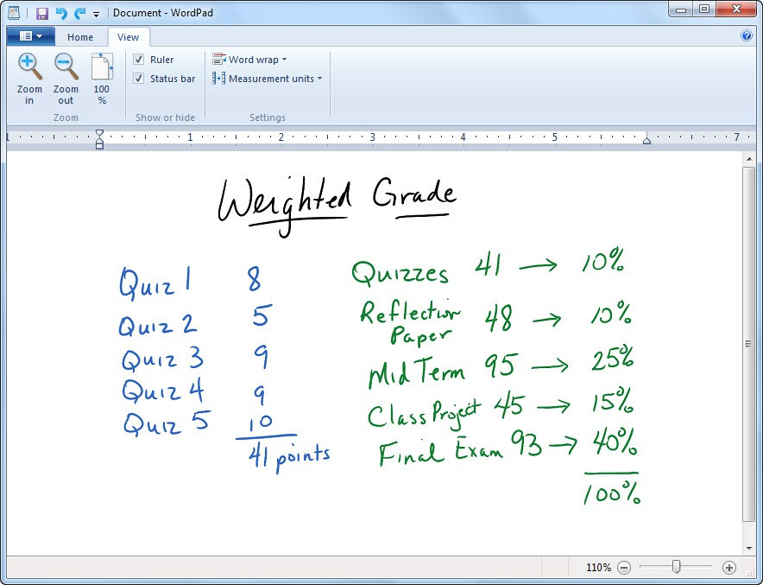
How Should tasks be weighted to construct the final grade?
General themes the course is already structured around:
Skill areas: writing, speaking, presentations, lab work, etc
Units or modules: course is broken into equal periods of time.
Learning Objectives: a list of different tasks that the learner must be able to perform at the end of the course.
A series of projects, tasks or experiences the learners must move through.
Each part should be weighted according to it’s significance to the course goals

Slide 33
What do you do when the class averages for a particular task are too low or too high?
Why did this happen??
Motivated learners, worked hard
Material was familiar and easy to master
Instruction was successful
The evaluator is reluctant to award lower scores
Test questions are ambiguous
Learner’s lack the knowledge to complete the assignment
Instructors expectations are too high
What can we do??
Scale the marks up or down
If the assessment tool was at fault you may consider redoing it.
Do not include the grade in the final assessment
Consider giving everyone equal credit for completing the task.
Discuss options with the learner and choose an action together

Slide 34
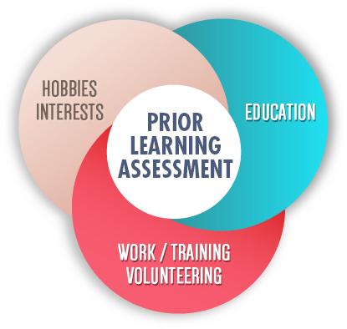
How should overall growth be considered in the final grade?
A good pre and post-test are the most common and effective way to measure a learner’s progress.
Examples of pre-course assignments to determine a learner’s entry knowledge
-paper and pencil test
-formal skill demonstration
-conference with the learner
-self assessment
-written description of prior learning
-Experience
-informal observation of the learner
-combination of all the above

Slide 35
Learner growth
-The criteria used during the pre-course assessment should be the same type used in the post-course assessment.
-Using either a letter or number grade compare the results of both pre and post course assessments.
-It’s important to remember that not all learning registers itself in levels.
-Nor can growth or the lack thereof be attributed solely to a particular program. External factors can influence learning such as family, workplace, community, life crises, access to other resources and much more.
-Learner growth should include both quantitative and qualitative commentary
DISADVANTAGES….
-learners entering the course with a high degree of understanding and skill do not show as much growth as those entering with little knowledge
-there are deep levels of learning that cannot be measured, some learners need time to be able to process and express their learning

Slide 36
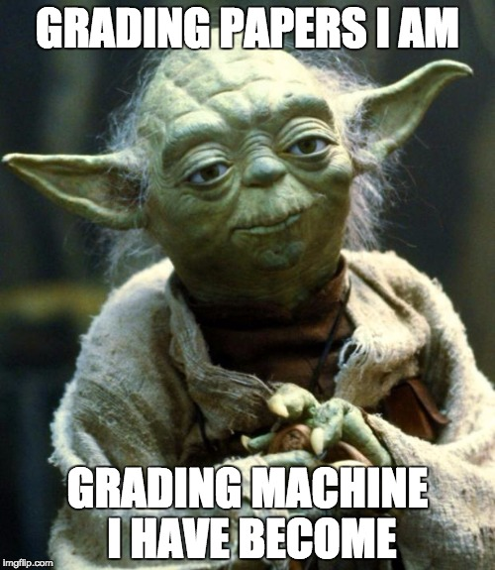
“In the end test scores and grades are not all that matter”

Slide 37
Question and Answer
You have questions
We have Answers

